Slide 1

Speech Reconstruction from EEG Signals Using Brain-Computer Interface (BCI) with Recurrent Quantum Neural Networks (RQNN)
2021UEC2661 | ANAND SHUKLA
2021UEC2699 | ASHISH KUMAR
2021UEC2694 | VIVEK JASUJANI
2021UEC2687 | AASTHA GUPTA
Mid Term Review
EEEEC22 B. Tech Project - I

Slide 2
Contents
Introduction
Literature Survey
Gaps Identified
Aims/Objectives of the Project
Problem Statement
Solution Methodology
Estimated Outputs
References

Slide 3
Introduction
Enhancing BCI Performance through Advanced EEG Signal Processing
Brain-Computer Interface (BCI)
Brain-Computer Interface (BCI) technology enables individuals with severe physical disabilities to interact with external devices using brain signals such as the electroencephalogram (EEG).
Utilizes brain signals (EEG)
Challenges with Raw EEG Signals
Low Signal-to-Noise Ratio (SNR) due to:
Electrical noise
Muscle artifacts
Eye movements

Slide 4
Current Solutions:
Traditional Filtering Methods
Savitzky-Golay and Kalman Filters
Limitations:
Require prior noise assumptions
Poor adaptability to dynamic environments
Proposed Solution:
Recurrent Quantum Neural Network (RQNN)
Models EEG as time-varying wave packets
Leverages Schrödinger Wave Equation for effective noise filtering

Slide 5
Literature Survey
Importance of EEG Signal Filtering
Low Signal-to-Noise Ratio (SNR) Challenges
Interference from:
Environmental noise
Motion artifacts
Biological signals (e.g., EMG)
Impact
Effective filtering enhances:
Signal clarity and separability
Downstream tasks such as:
Speech reconstruction
Motor imagery classification

Slide 6
Table 1: Comparison of EEG Filtering Methods
S.No | Method | Strengths | Limitations
1. | Kalman Filter | Good for time-varying signal estimation | Assumes Gaussian noise, not suited for nonstationary signals
2. | Savitzky-Golay | Smooths noisy data, easy to implement | Struggles with dynamic noise, can distort EEG features
3. | Convolutional Neural Networks (CNN) | Effective for recognizing patterns in noisy signals | Requires large datasets and struggles with real-time adaptation
4. | Recurrent Neural Networks (RNN) | Good for sequential data modeling | Struggle with noisy, nonstationary EEG data
5. | Quantum Neural Networks (QNN) | Dynamically adapts to nonstationary signals using quantum principles | Relatively new and requires subject-specific tuning

Slide 7
Why Quantum Neural Networks (QNN)?
Motivation for QNN
Brain signals are inherently non-stationary.
Traditional methods fail to adapt to dynamic nature.
QNN Advantages
Treats EEG signals as time-varying wave packets.
Facilitates:
Real-time filtering
Enhanced noise reduction
Expected Outcomes
Improved SNR
More accurate speech reconstruction

Slide 8
Gaps Identified
Research Gaps Identified
Limited Adaptability of Existing Methods
Traditional filtering fails to accommodate nonstationary EEG signals.
Performance in Real-Time Applications
Current models (e.g., CNNs, RNNs) struggle with noisy data.
Need for Advanced Filtering Techniques
No existing method fully utilizes the potential of quantum mechanics for EEG processing.

Slide 9
Aims/Objectives of the Project
Motivation
Enhancing BCI Performance: Address low signal-to-noise ratio (SNR) in EEG signals for effective communication in individuals with disabilities.
Limitations of Traditional Methods: Existing filters (Savitzky-Golay, Kalman) are not adaptable to the dynamic nature of EEG signals.
Innovative Solution: Introduce Recurrent Quantum Neural Network (RQNN) to filter EEG signals without assumptions about noise.
Research Objectives
Design RQNN Model: Utilize Schrödinger Wave Equation (SWE) for advanced EEG filtering.
Improve SNR: Enhance EEG signal quality without prior assumptions about noise characteristics.

Slide 10
Problem Statement
Key Issue
Noisy EEG Signals: BCIs rely on EEG signals that are often contaminated by noise, significantly hindering system performance and effectiveness.
Traditional Filters' Shortcomings
Inability to Adapt: Conventional filtering methods fail to manage the dynamic and nonstationary nature of EEG signals, resulting in inaccuracies in signal processing.
Proposed Solution
Recurrent Quantum Neural Network (RQNN): Introduce a quantum-inspired model aimed at improving EEG signal quality and enhancing BCI performance by effectively addressing noise challenges.

Slide 11
Solution Methodology
1. Dataset
Utilize a suitable EEG-to-speech dataset (public sources or custom-recorded).
2. Model
Implement a Quantum Neural Network (QNN) that leverages the Schrödinger Wave Equation for processing and filtering EEG signals for speech reconstruction.
3. Speech Reconstruction
Train the QNN model to predict speech parameters (e.g., formants, pitch) from EEG data.

Slide 12
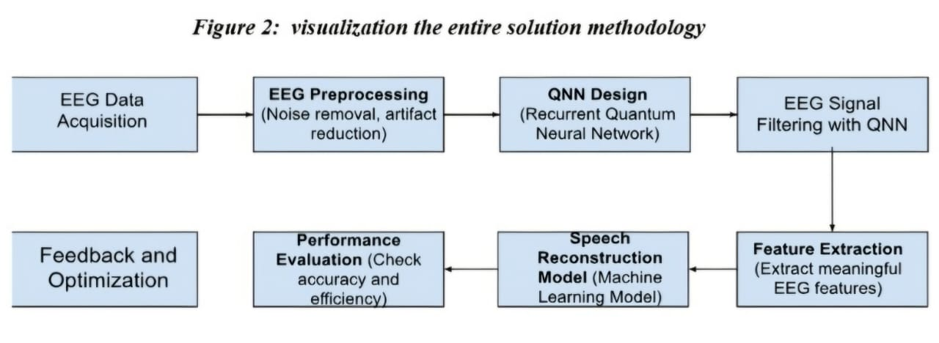
4. Validation
Validate the model by comparing the reconstructed speech with original recordings.

Slide 13
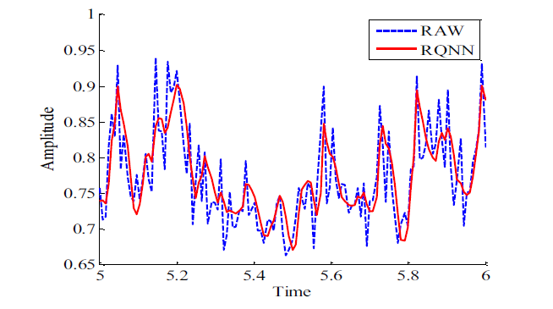
EXPECTED RESULTS
1. TRUE EEG SIGNALS OBTAINED THROUGH RQNN FILTERING
True EEG signals are extracted from the noisy EEG signals through RQNN filtering.

Slide 14
PREDICTING THE STATE OF MIND THROUGH FREQUENCY OF EEG SIGNALS
True EEG signals are analyzed to predict the person’s state of mind.
S. No | Brainwave | Frequency | State | Associated Work/Task
1. | Delta | 0.5 – 4 Hz | Deep sleep, unconsciousness | Physical healing, immune function, deep sleep recovery
2. | Theta | 4 – 8 Hz | Deep relaxation, meditation | Creativity, daydreaming, REM sleep, intuitive insight, light meditation
3. | Alpha | 8 – 12 Hz | Calm but alert, relaxed focus | Creative visualization, relaxed focus, mindfulness, meditation
4. | Beta | 12 – 30 Hz | Active thinking, focus | Problem-solving, logical analysis, decision making, learning
5. | Gamma | 30 – 100 Hz | Peak mental focus, information processing | Learning, memory recall, complex problem-solving, insight

Slide 15
References
[1] L. Behera and I. Kar, “Quantum stochastic filtering,” in Proc. IEEE Int. Conf. Syst., Man Cybern., Oct. 2005, pp. 2161–2167
[2] R. G. Richard, Brain-Computer Interfaces: Principles and Practice, 1st ed. Oxford, UK: Oxford University Press, 2014.
[3] V. Gandhi, G. Prasad, D. Coyle, L. Behera, and T. M. McGinnity, "EEG-based brain-computer interface for speech reconstruction," IEEE Trans. Neural Syst. Rehabil. Eng., vol. 23, no. 5, pp. 727-738, Oct. 2015.
[4] Google Scholar, IEEE Xplore Digital Library, [Online]. Available: https://scholar.google.com/ and https://ieeexplore.ieee.org/ (accessed on Sep. 23, 2024).

Slide 16
Thank You.
2021UEC2661 | ANAND SHUKLA
2021UEC2699 | ASHISH KUMAR
2021UEC2694 | VIVEK JASUJANI
2021UEC2687 | AASTHA GUPTA
Mid Term Review
EEEEC22 B. Tech Project - I

